Slide 1



Malignant Comment Project Case Study
NOV 20 – DEC 4, 2022
Submitted by: Promise Azom

Slide 2
Outline
Data Description
EDA steps and Visualizations
Steps and Assumptions
Model Dashboard
Finalized Model & Conclusion

Slide 3

Data Description

Slide 4
Overall narrative summary of data: There are total 159,571 and 153,164 observation in our Malignant Comments Training and Test dataset respectively.
There are total of 8 variables in our dataset.
We adopted all variables during model building
Data contained no Null values
Data contains numerical as well as categorical variable
1
2
3
4
5

Slide 5
Summary of Variables

Slide 6

EDA STEPS
& VISUALIZATION

Slide 7
I employed both univariate, bivariate and multivariate analysis;
Plotted countplots, heatmaps, scatter plot and bar plots
Used all features in the analysis
I didn’t drop any columns because multicollinearity did not exist
1
2
3
4

Slide 8

PROCESS STEPS & ASSUMPTIONS

Slide 9
I started by viewing the data and checking for null values;
I checked what kind of datatypes the dataset were made up of
I determined the target variable or labels.
1
2
3

Slide 10
MODEL DASHBOARD

Slide 11
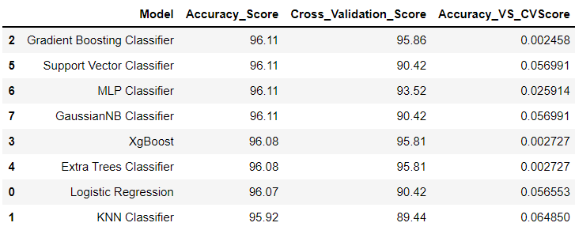
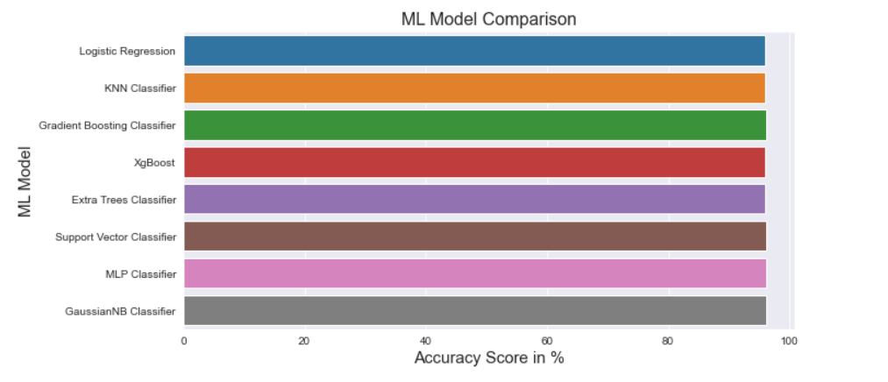
Comparing all Eight Models Built
Now from the above diagram it seems we have four models; Gradient Boosting, Support Vector, MLP and Guassian Classifiers producing the Highest Accuracy(96%), However, our aim is to find the BEST MODEL, so if we consider the difference Between Accuracy_Score and Cross_Validation_Score....

Slide 12
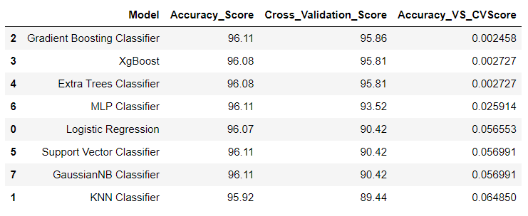
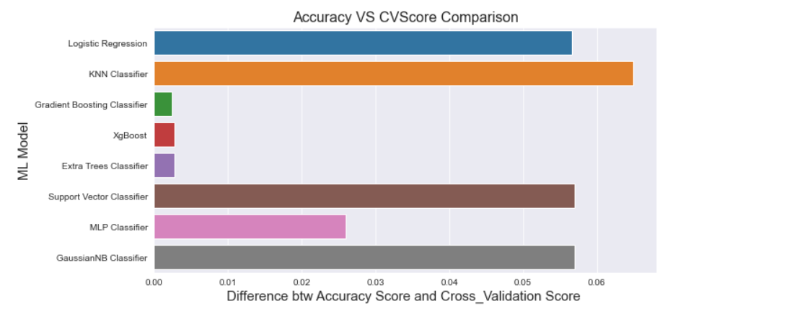
Comparing Differences between Accuracy and Cross_Validation Scores...
From the above we can see the Model with least difference is Gradient Boosting Classifier!

Slide 13

Finalized Model & Conclusion

Slide 14
1
From the above we can see:
- The Model with least difference (0.002) between Accuracy Score and Cross Validation Score is GRADIENT BOOSTING REGRESSOR!
2
Accuracy is 96%
We also went further to engage in Hyperparamter Tunning using
GridSearchCV
3
FINAL ACCURACY after Hyperparameter Tunning: 96.11%
4

Slide 15
Thank You

